Slide 1

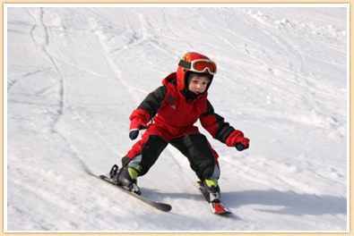
11. Skier
Let’s Learn
Aj. Andrew Davison, CoE, PSU Hat Yai Campus
E-mail: ad@fivedots.coe.psu.ac.th

Slide 2
Outline
The Skier Game
skier.py Classes
The main Program
Support Functions used in main
The Obstacles Class
The AnimSprite Class
The PicsSprite Class
The Skier Class
The Button Class

Slide 3
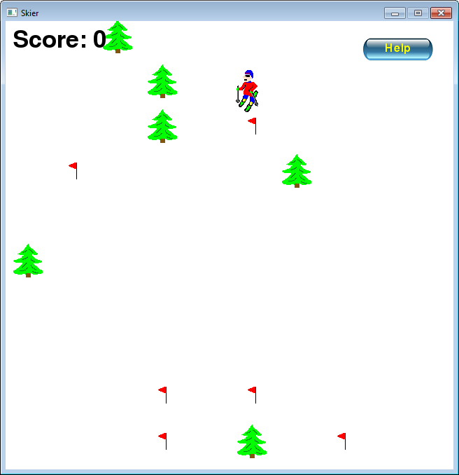
1. The Skier Game
A Button sprite
which can be
"pressed"
The obstacles
move up, so
it looks like the
skier is moving
down.
The player
can move left
and right
horizontally.
The image
changes
to show the
direction.
Two kinds of
Obstacles –
flags and trees
Hitting obstacles
changes the score
and displays an
animated explosion

Slide 4
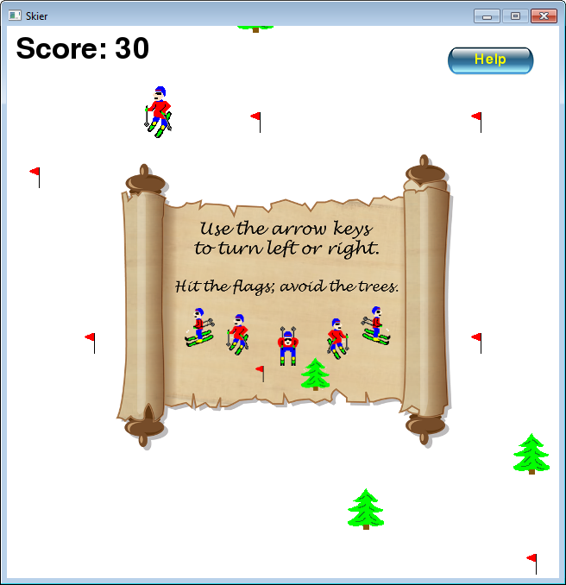
Help 'Screen'
The help screen
is a picture which
appears when
the user presses
the Help button.
The game
pauses while
the help picture
is visible.
The help
disappears, and
the game
resumes, when
the user
presses the Help
button again.
Typing 'p'
causes the
game to pause
or resume.

Slide 5
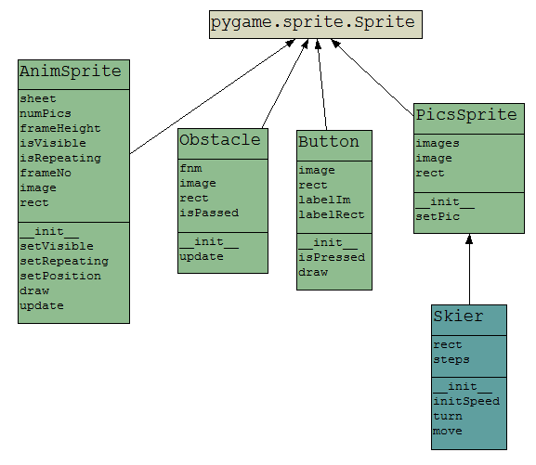
2. invaders.py Classes
inherits
variables
functions
inherits
Almost the
same class as
used in the
invaders game;
update() is new

Slide 6
Objects made by Classes
The Skier class inherits PicsSprite so it can change between different images
there is one skier object for the player
The Button class is used to make the button sprite
Many Obstacle sprites are created for trees and flags during the game
1 animation is made from AnimSprite
used for tree and flag explosions

Slide 7
Support Functions used in main
def makeObstacles():
: # create trees/flags at random positions off the # bottom of the screen
def checkCollisions():
: # check for a collision between the skier # and any obstacle
def isGameOver():
: # has player won (score > 90) or lost (score < -90)?
def centerImage():
: # draw an image in the center of the window

Slide 8
3. The main Program
pygame.init()
screen = pygame.display.set_mode([640, 640])
pygame.display.set_caption('Skier')
scrWidth, scrHeight = screen.get_size()
font = pygame.font.Font(None, 50)
# load game sounds
pygame.mixer.music.load('arpanauts.ogg')
pygame.mixer.music.play(-1)
pygame.mixer.music.set_volume(0.7)
boom = pygame.mixer.Sound('boom.wav')
# game vars
isPaused = False
showHelp = False
gameOver = False
finalMsg = ""
score = 0
Music and
sound effect
game state booleans for
pausing, showing help and
game playing

Slide 9
# create sprites and groups
skier = Skier(scrWidth/2)
yLandPos = 0 # y position of skier on the land
explo = AnimSprite('exploSheet.png', 10)
# create obstacles
obstacles = pygame.sprite.Group() # group of obstacles
makeObstacles()
button = Button("Help", (scrWidth-80, 40))
instructions = pygame.image.load("instructions.png").convert_alpha()
Instructions as
a picture

Slide 10
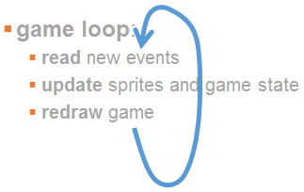
clock = pygame.time.Clock()
running = True
while running:
clock.tick(30)
# handle events
for event in pygame.event.get():
if event.type == QUIT:
running = False
if event.type == MOUSEBUTTONDOWN:
if button.isPressed( pygame.mouse.get_pos() ):
# print('button pressed')
showHelp = not showHelp # toggle
isPaused = showHelp
if event.type == KEYDOWN:
if event.key == K_p:
isPaused = not isPaused # toggle
elif event.key == K_ESCAPE:
running = False
elif event.key == K_LEFT: # left arrow turns left
skier.turn(-1)
elif event.key == K_RIGHT: # right arrow turns right
skier.turn(1)
game state changes
for help and pausing

Slide 11
game is updated only if
game is not over and not
paused
# update game
if not gameOver and not isPaused:
skier.move()
# create new obstacles if skier is at end of old obstacles
yLandPos += skier.steps[1]
if yLandPos >= scrHeight: # skier at bottom of land?
makeObstacles()
yLandPos = 0 # reset so skier at top of land
checkCollisions()
# update obstacles and explosion based on skier's y "step"
obstacles.update( skier.steps[1] )
explo.update(skier.steps[1])
gameOver = isGameOver()

Slide 12
# redraw game
screen.fill(WHITE)
button.draw(screen)
obstacles.draw(screen)
screen.blit(skier.image, skier.rect)
explo.draw(screen)
screen.blit(font.render("Score: " +str(score), 1, BLACK), [10, 10])
if gameOver:
centerImage(screen, font.render(finalMsg, True, RED))
elif isPaused:
if showHelp:
centerImage(screen, instructions)
else:
centerImage(screen, font.render('Paused...', True, BLACK))
pygame.display.update()
pygame.quit()
game state affects
what is drawn
in 3 ways

Slide 13
4. Support Functions used in main
def makeObstacles():
: # create trees/flags at random positions off the # bottom of the screen
def checkCollisions():
: # check for a collision between the skier # and any obstacle
def isGameOver():
: # has player won (score > 90) or lost (score < -90)?
def centerImage():
: # draw an image in the center of the window

Slide 14
The makeObstacle() Function
def makeObstacles():
# create trees/flags at random positions off the
# bottom of the screen
locs = []
for i in range(10): # 10 obstacles
row = random.randint(0, 9)
col = random.randint(0, 9)
loc = [(col * scrWidth/10) + 32,
(row * scrWidth/10) + 32 + scrHeight]
# (x,y) center for an obstacle
if not (loc in locs): # prevent 2 obstacles from
# being in the same place
locs.append(loc)
type = random.choice(["tree", "flag"])
if type == "tree":
obstacles.add( Obstacle("tree.png", loc) )
else: # a flag
obstacles.add( Obstacle("flag.png", loc) )

Slide 15
The checkCollision() Function
def checkCollisions():
global score
hits = pygame.sprite.spritecollide(skier, obstacles, False)
if hits:
if not hits[0].isPassed: # has skier not passed obstacle?
explo.setPosition( hits[0].rect.center )
explo.setVisible(True)
boom.play()
hits[0].isPassed = True
if hits[0].fnm == "tree.png": # hit a tree
score -= 10
skier.initSpeed()
else: # hit a flag
score += 10
hits[0].kill() # remove the flag
Position and
show the
explosion, and
play a sound.
Nothing deleted
when there is a
collision.

Slide 16
5. The Obstacle Class
class Obstacle(pygame.sprite.Sprite):
def __init__(self, fnm, loc):
super().__init__()
self.fnm = fnm
self.image = pygame.image.load(fnm)
self.rect = self.image.get_rect()
self.rect.center = loc
self.isPassed = False
def update(self, step):
self.rect.y -= step
if self.rect.y < -self.rect.height: # if above top
self.kill()

Slide 17
6. The AnimSprite Class
This class is almost the same as the one in invaders.py except that an animation must move vertically.
This is required because the game is a top-scroller, and so everything (except the skier) must move up as the game progresses.

Slide 18
def update(self, step):
# movement function needed since using
# AnimSprite in a top-scroller
if self.rect.y > 0: # if below top of window
self.rect.y -= step # move up
else:
self.setVisible(False)
Compare to update() in
the Obstacle class – reuse
the object by making it invisible

Slide 19
7. The PicsSprite Class
A list of picture
file names
class PicsSprite(pygame.sprite.Sprite):
def __init__(self, fnms):
super().__init__()
self.images = []
for fnm in fnms:
self.images.append(
pygame.image.load(fnm + ".png").convert_alpha() )
self.image = self.images[0]
self.rect = self.image.get_rect()
def setPic(self, idx):
center = self.rect.center
self.image = self.images[idx]
self.rect = self.image.get_rect()
self.rect.center = center
Switch to picture
in position idx
in the list

Slide 20
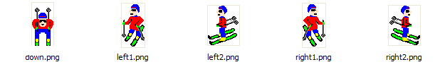
8. The Skier Class
A list of picture
file names for
the skier
class Skier(PicsSprite):
def __init__(self, x):
super().__init__(["down", "right1", "right2",
"left2", "left1"])
self.rect.center = [x, 100]
self.initSpeed()
def initSpeed(self):
self.steps = [0, SKIER_STEP] # in x- and y- dirs
self.setPic(0)

Slide 21
def turn(self, dirChange):
dir = self.steps[0] + dirChange
if dir < -2: # restrict direction to -2 to 2
dir = -2
if dir > 2:
dir = 2
self.steps = [dir, SKIER_STEP - abs(dir)*2]
self.setPic(dir)
def move(self):
# move the skier right and left
self.rect.centerx += self.steps[0]
if self.rect.x < 0: # stay visible in window
self.rect.x = 0
if self.rect.x > (scrWidth - self.rect.width):
self.rect.x = scrWidth - self.rect.width
Changes the
y- 'step'
based on the
direction.
The y- 'step'
is not used by the
skier; it is used
to update the
obstacles in main

Slide 22

9. The Button Class
Loads a button
picture then
writes a label on
top of it.
class Button(pygame.sprite.Sprite):
def __init__(self, label, pos):
super().__init__()
self.image = pygame.image.load("button.png").convert_alpha()
self.rect = self.image.get_rect()
self.rect.center = pos
font = pygame.font.Font(None, 24)
self.labelIm = font.render(label, True, YELLOW)
self.labelRect = self.labelIm.get_rect()
self.labelRect.x = self.rect.x + \
(self.rect.width - self.labelIm.get_width())/2
self.labelRect.y = self.rect.y + \
(self.rect.height - self.labelIm.get_height())/2

Slide 23
Mouse pressing is
checked in the game
loop. Here only check
if the mouse is "inside"
the button.
def isPressed(self, mousePos):
return self.rect.collidepoint(mousePos)
def draw(self, screen):
screen.blit(self.image, self.rect)
screen.blit(self.labelIm, self.labelRect)

Slide 24
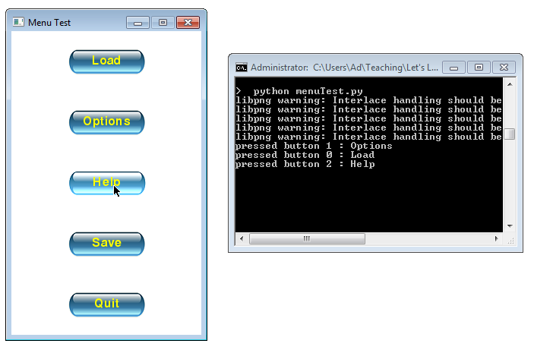
A more fancy Button class is used in the "Menu Test" example in the Other Games folder.
The buttons change color when the mouse moves over them.

